Slide 1
PYTHON,FAST API,POSTMAN, MONGODB
BY
R.SHREEMATHI
M.ISHWARIYA

Slide 2
FAST API
INTRODUCTION OF FAST API
INSTALLATION OF POSTMAN
CLIENT : POSTMAN
SERVER:UVICORN
SAMPLE CODES UNDER CONNECTING POST MAN AND VS CODE

Slide 3
RUNNING PROCESS
TO run the vscode we need to install some packages and that packages are given below
Pip install fastapi
Pip install “uvicorn[standard]”
Pip install jinja2
Pip install python-multipart
After complete the installation process to run the program :uvicorn main:app --reload

Slide 4
CRUD METHODS
CRUD- Create Retrive Update Delete
In this we have some methods:
Get method
Put method
Post method
Update method
Delete method
Find_one method

Slide 5
MONGODB(DATABASE)
First create a account in mongodb
Crate database with database name and collection name
Copy the url in mongodb
Paste it vscode to connect the database

Slide 6
Project student result management
IN OUR PROJECT WE GIVEN THE DETAILS ABOUT THE SCHOOL
MOTO OF THE SCHOOL
FUTURE GOAL OF SCHOOL
VISION AND MISSION OF COLOLEGE
REGISTRATION PAGE
STUDENT RESULT
ADMIN PAGE
SCHOOL EXAM DETAILS

Slide 7
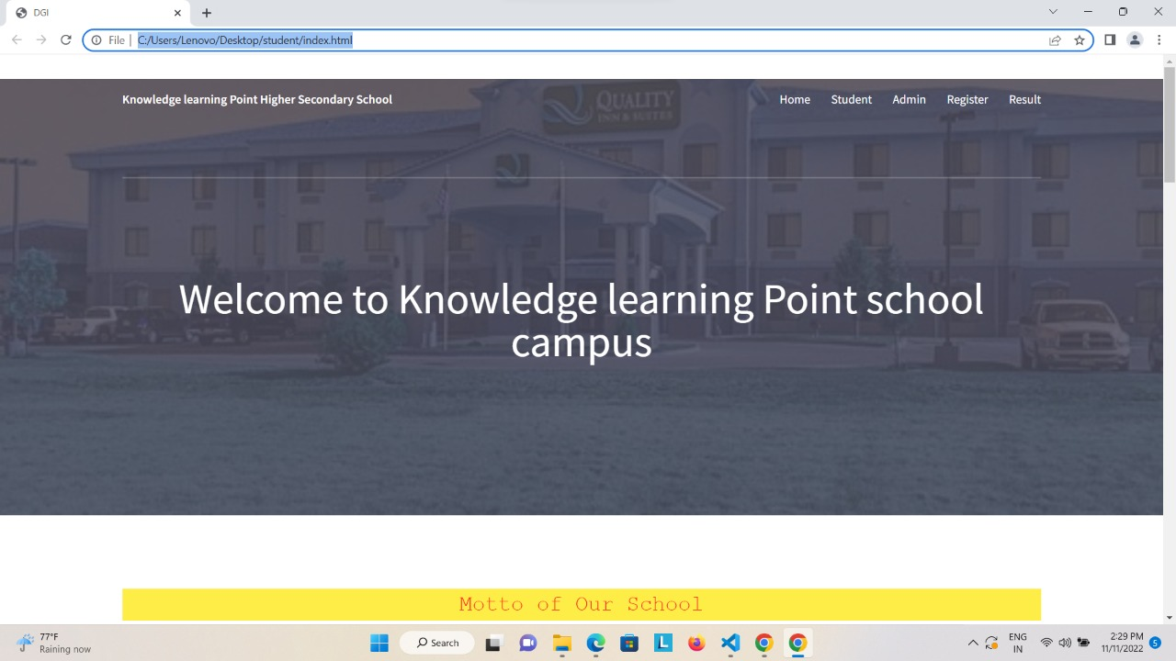
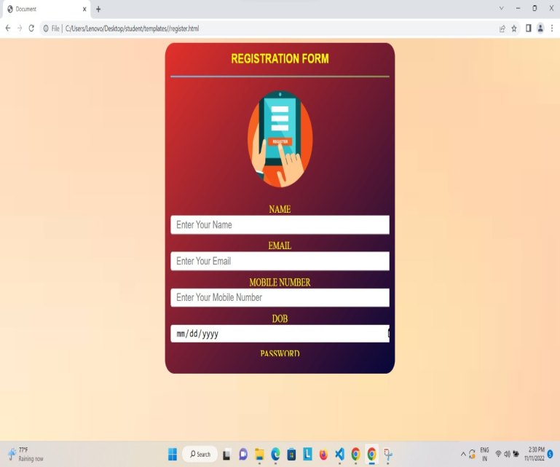
frontend
In this project we used html css as frontend .
home page registration page

Slide 8
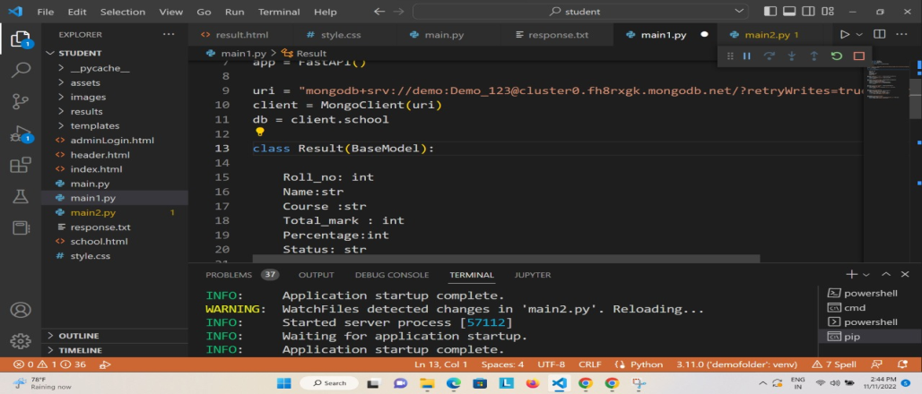
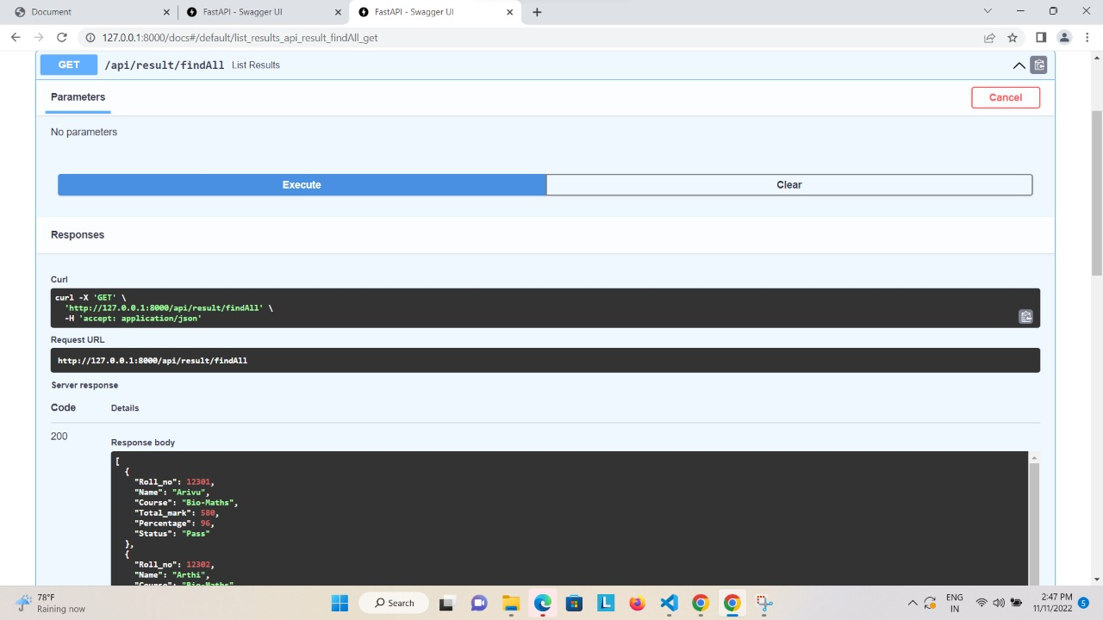
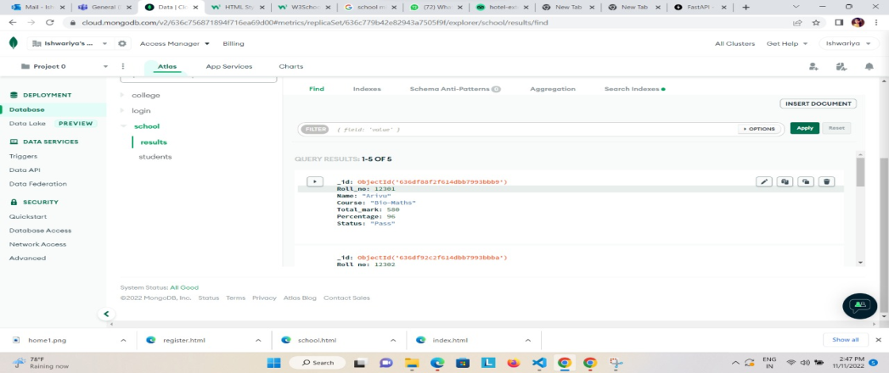
backend
In this project we used python,FastAPI,mongodb as backend.

Slide 9

THANK YOU

